Slide 1
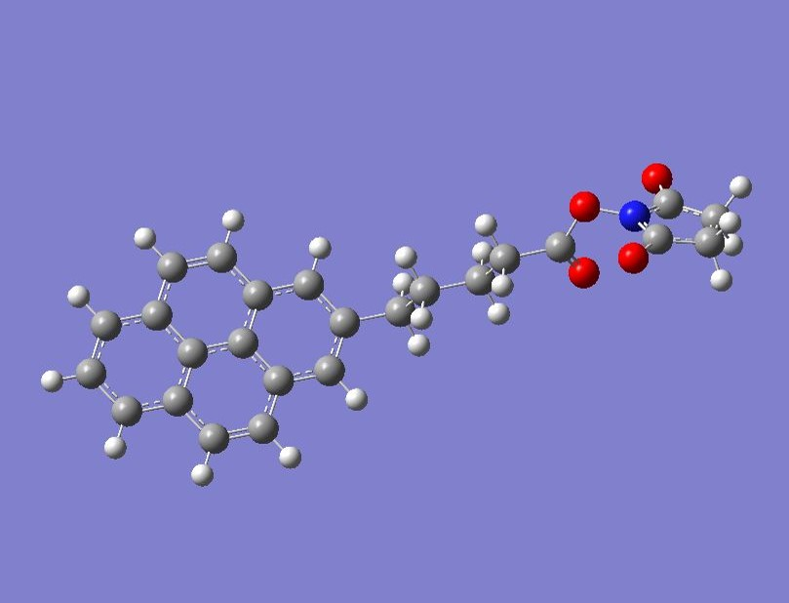
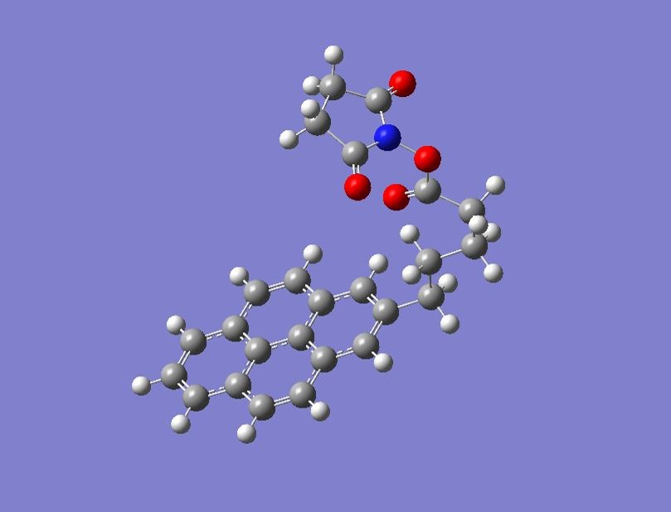

Slide 2
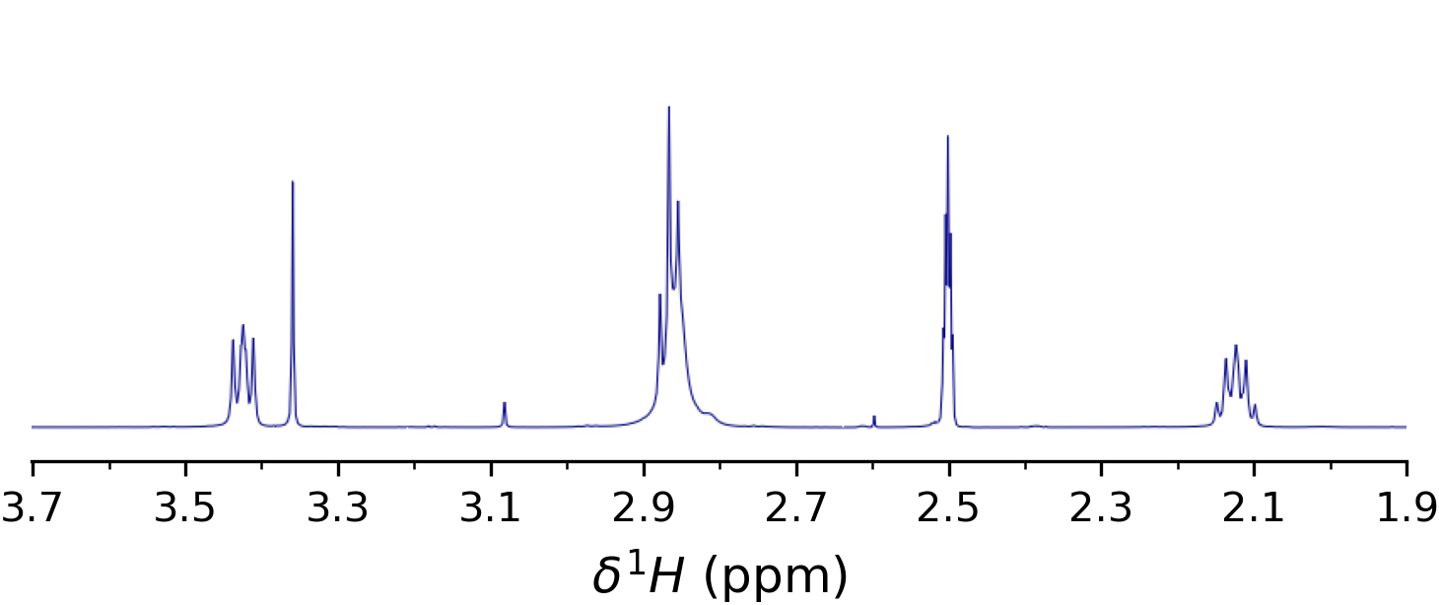
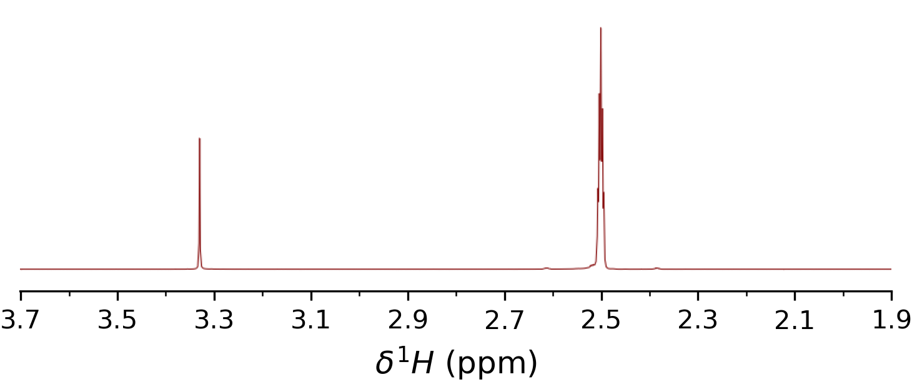
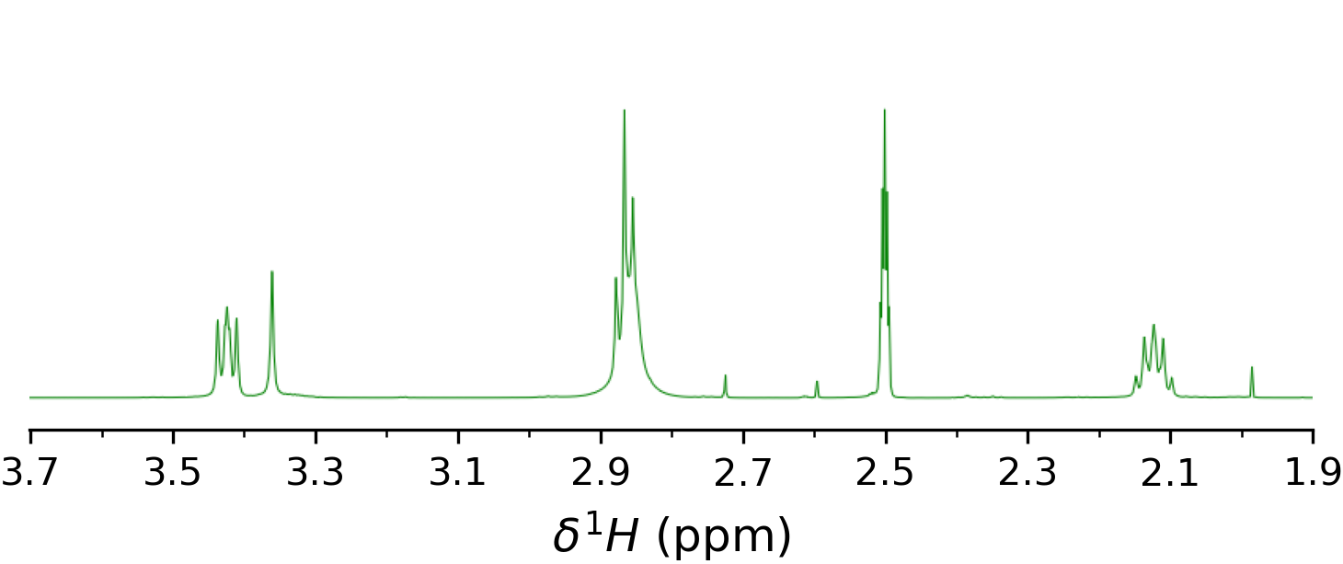
DMSO
H₂O
PBASE
DMSO
PBASE
H₂O
PBASE
PBASE
DMSO
PBASE
H₂O
PBASE

Slide 3
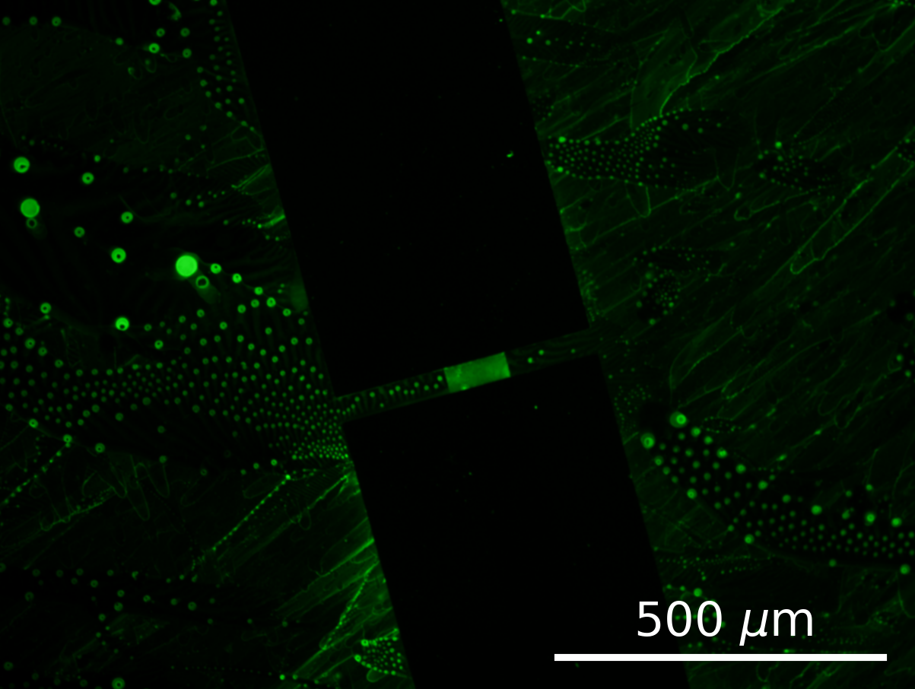
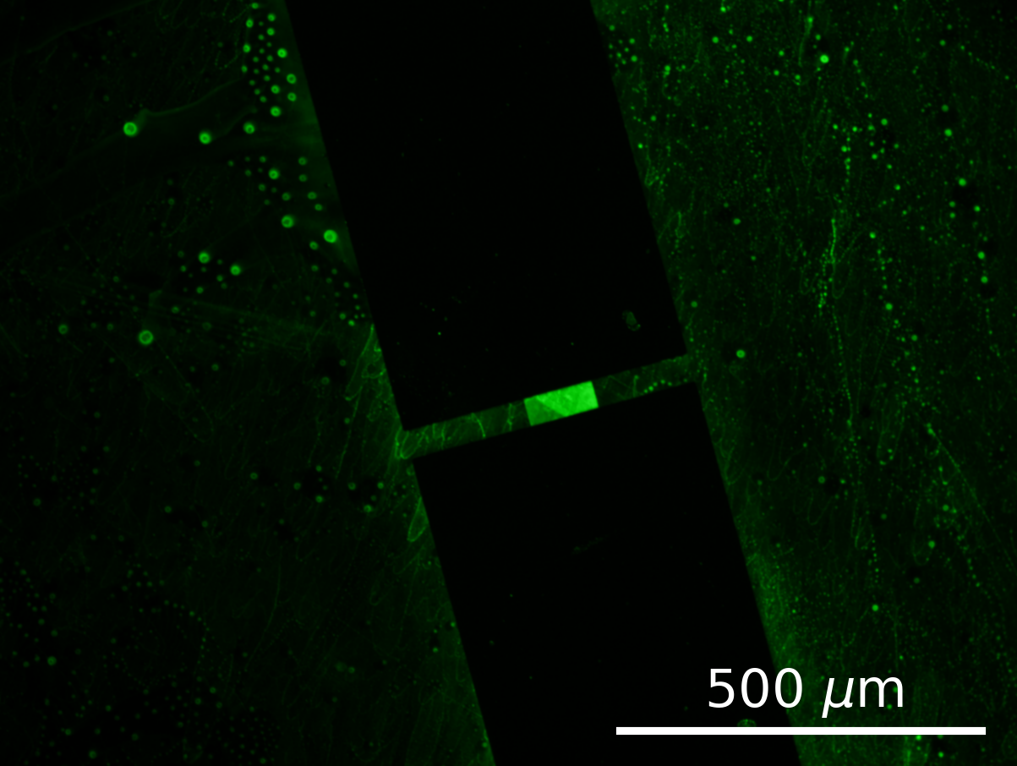
SiO₂
SiO₂
Ti/Au
Ti/Au
Graphene
Graphene
Ti/Au
Ti/Au
SiO₂
SiO₂

